Slide 1
GWRC Plan Change 1 Hearing Stream 3 Background
Since 1992, my wife and I have owned a forestry block on 220 of hill country in Te Horo.
The majority of the land is in regenerating indigenous forest, with around 80 ha of plantation forest including cypresses, durable eucalypts and radiata pine
I have been gone through whole lifecycle of a forest from afforestation to harvesting and replanting. And we have set aside some forest originally destined for harvesting as a carbon forest
I have been involved in the development of the NES-PF/CF, the ETS and run workshops on behalf of Te Uru Rakau (MPI) to educate small growers on forestry matters. I am also serving on the Environment Committee of the forestry sector
The New Zealand Farm Forestry Association has around 1200 members and on its behalf I have written a submission focussing mainly on the issues arising for small growers

Slide 2
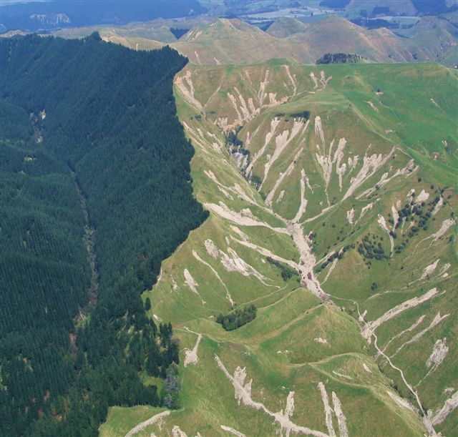
Benefits of Forestry

Slide 5
NES-CF ≠ NES-PF
New Schedule 3: Extensive documentation and mapping requirements for planting/replanting including erosion management plans
Earthworks Schedule 4: new requirements
Para 3(e): estimated earthworks cut and fill volumes, by ESC zone
Para 3(h): design rainfall event size and duration that has been used to design the sediment control measures
Slash management conditions
Permanent forestry included
NES-CF was not permitted to show that it improves outcomes

Slide 6
Comment on Evidence
Plan Change 1 became effective 3 November 2023
Consents required for planting/replanting /earthworks/harvesting since then
No evidence presented that
Water quality/sedimentation has improved or
How many consents have been issued that would not have been required under the NES or
How many of these consents had conditions different from those in the NES-CF or
Any improvements with regards to staffing levels/expertise in enforcement team

Slide 7
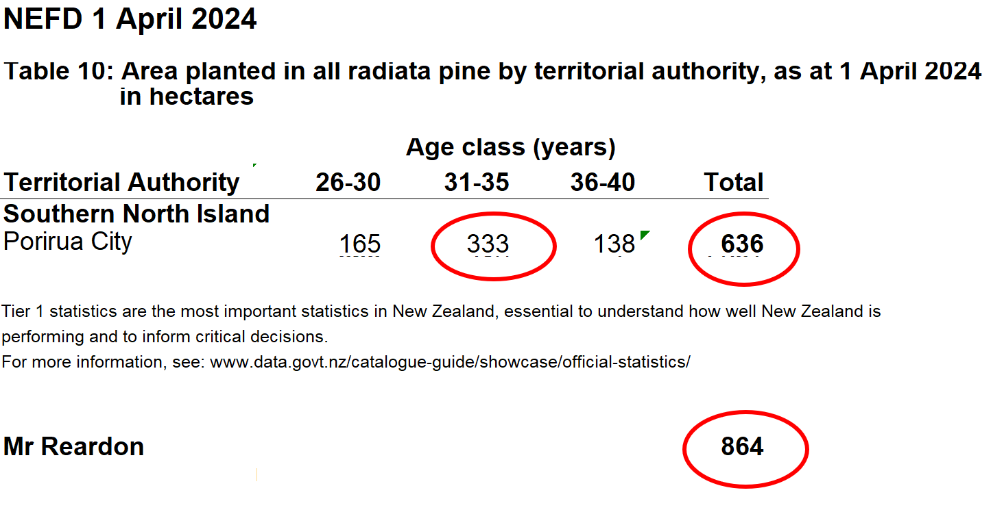
Comments on Rebuttal
Projected increase of 40 % in harvesting volumes challenged by Mrs Strang – but her evidence was not adressed/refuted

Slide 8
Comments on Rebuttal Effect of TAS on Consent Requirements
SOE Monitoring Site | Total Area (ha) | Suspended | Native | Pastoral | Plantation Forest | Other
 |  | Fine Sediment
 |  | Current State
Horokiri Stream at Snodgrass | 2,884 | C | 14% | 41% | 30% | 16%
Whakatikei River at Riverstone | 8,073 | A | 67% | 6% | 24% | 2%
Hulls Creek Adjacent to Reynolds | 1,517 | A | 31% | 1% | 22% | 46%
Akatarawa River at Hutt Confluence | 11,651 | A | 79% | 3% | 17% | 1%
Mangaroa River at Te Marua | 10,370 | D** | 49% | 31% | 16% | 5%
Pāuatahanui Stream at Elwood Bridge | 3,943 | D** | 21% | 58% | 15% | 5%
Hutt River at Bolcoutt | 61,021 | B** | 66% | 11% | 12% | 11%
Porirua Stream at Milk Depot | 4,026 | A | 13% | 31% | 11% | 45%
Pakuratahi River Below Farm Creek | 8,047 | A | 70% | 11% | 8% | 11%
Mākara Stream at Kennels | 7,203 | D** | 7% | 64% | 8% | 21%
Wainuiomata River D/S of Whites Bridge | 13,221 | C** | 65% | 8% | 3% | 24%*
Total area | 131,956
Total area where restricted discretionary consent not required | 36,198
Percentage where consent required | 73%
Mr Watson: | 61%

Slide 9
Comments on Rebuttal Consenting
Costs of consenting (Applicants internal and external costs)
Survey of 6 forestry companies: Lowest cost Highest cost
Average $8,667 $41,400
Examples in Appendix 3 (Mr Watson’s evidence): 3 consents one of which had one external council expert involved, and another had 3 external experts involved
Effect of consenting costs – best case scenario
Assumption: 10 hectares in forest, $1000 pa in rates, 500 insurance and 800 for forest management
 | harvest income of $20,000/ha at age 27, land provided at no cost, no ETS
 |  | Internal rate of return |  |  | Reason for change
NES-PF |  | 4.54%
NES-CF |  | 4.01% |  |  | New planting/replanting req.
Plan Change 1 |  | 3.02% |  |  | Resource consents

Slide 10
Comments on Rebuttal Consenting
Other risks with consenting costs
No council expertise – external consultants will largely drive process (Mr Watson- S42A report), costs can easily spiral out of control
Timeframes for consenting are unpredictable / consent may not be granted
Conditions may make project uneconomical
Matters for discretion: what species to plant
Mr Watson in Rebuttal: Forest owners only expected to provide information already required => no extra costs. Contradicts Mr Pepperell: wants to be able to change management plans to improve outcomes
Additional requirements in Forest Management Plan c(ii)
A plan(s) or map(s) identifying any sites or features listed in Schedule A (outstanding water bodies), Schedule C (mana whenua), Schedule F1, F2 or F3 (ecosystems and habitats with indigenous biodiversity), Schedule H (contact recreation and Māori customary use) and Schedule I (important trout fishery rivers and spawning waters) within or adjacent to land subject to commercial forestry activity
Geotechnical assessment required where even one pixel = 25m2 is mapped as “potential erosion risk land”. Also covers “adjacent” land

Slide 11
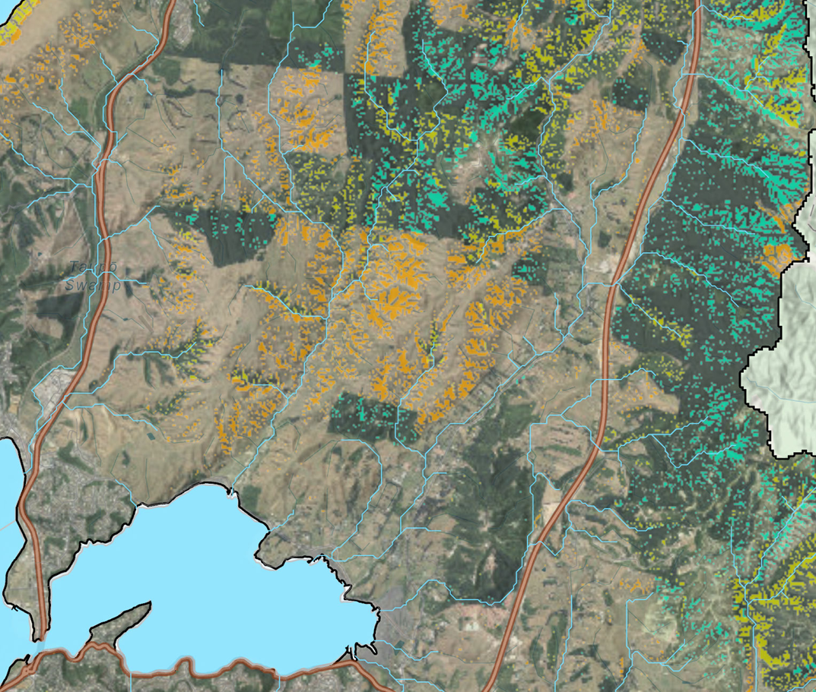
Comments on Rebuttal Consenting

Slide 12
Comments on Rebuttal Effect of not obtaining consent at acceptable conditions
No earthworks or harvesting consent => no return on 27 year investment, going forward only costs, no income
No replanting consent => if pre-90 forest deforestation liability $50,000/ha
=> if in ETS under averaging, liability for carbon reduction
=> going forward generally no income, only costs and devaluation of land
=> no replanting means land will be longer without vegetation cover, increasing sediment discharged

Slide 13
Comments on Rebuttal Items not addressed in Rebuttal
Para 9 of my supplementary submission: Section 32 requirements for making forestry controlled/restricted discretionary activity not met
- MFE Guidance for S32 reports: “……This means the most appropriate option does not need to be the most optimal or best option, but must demonstrate that it will meet the objectives in an efficient and effective way.”
- Dr. Greer: “Thus, it is uncertain whether either the PC1 provisions or the NES-CF will contribute to the TAS being met, or that one will achieve demonstrably greater sediment losses than the other”.

Slide 14
Concluding remarks
Dr. Greer: “In terms of sediment, commercial forests discharge less than any other commercial land use, and are second only to indigenous forests”.
Whaitua recommendations are in favour of using NES-PF: e.g. Rec. 55: “Upon receiving notice under the NES-PF of earthworks, forestry quarrying or harvesting in the Te Awarua-Porirua Whaitua .…. actively monitors compliance to ensure sediment discharges to waterbodies are minimised”
Mrs Strang’s evidence: “the evidence provided does not justify over-riding the NES CF and requiring resource consent for all of the listed plantation forestry activities”
As per Mr. Wyeth evidence, the requirement for more stringency have not been demonstrated and “the NES-CF with non-regulatory support to improve implementation ... is likely to be more effective and efficient” than what is proposed in PC1
Should the hearing panel deem it necessary to be more stringent than the NES-CF for earthworks, harvesting, vegetation clearance or mechanical land preparation, then we ask that afforestation and replanting remain regulated under the NES-CF

