Slide 1
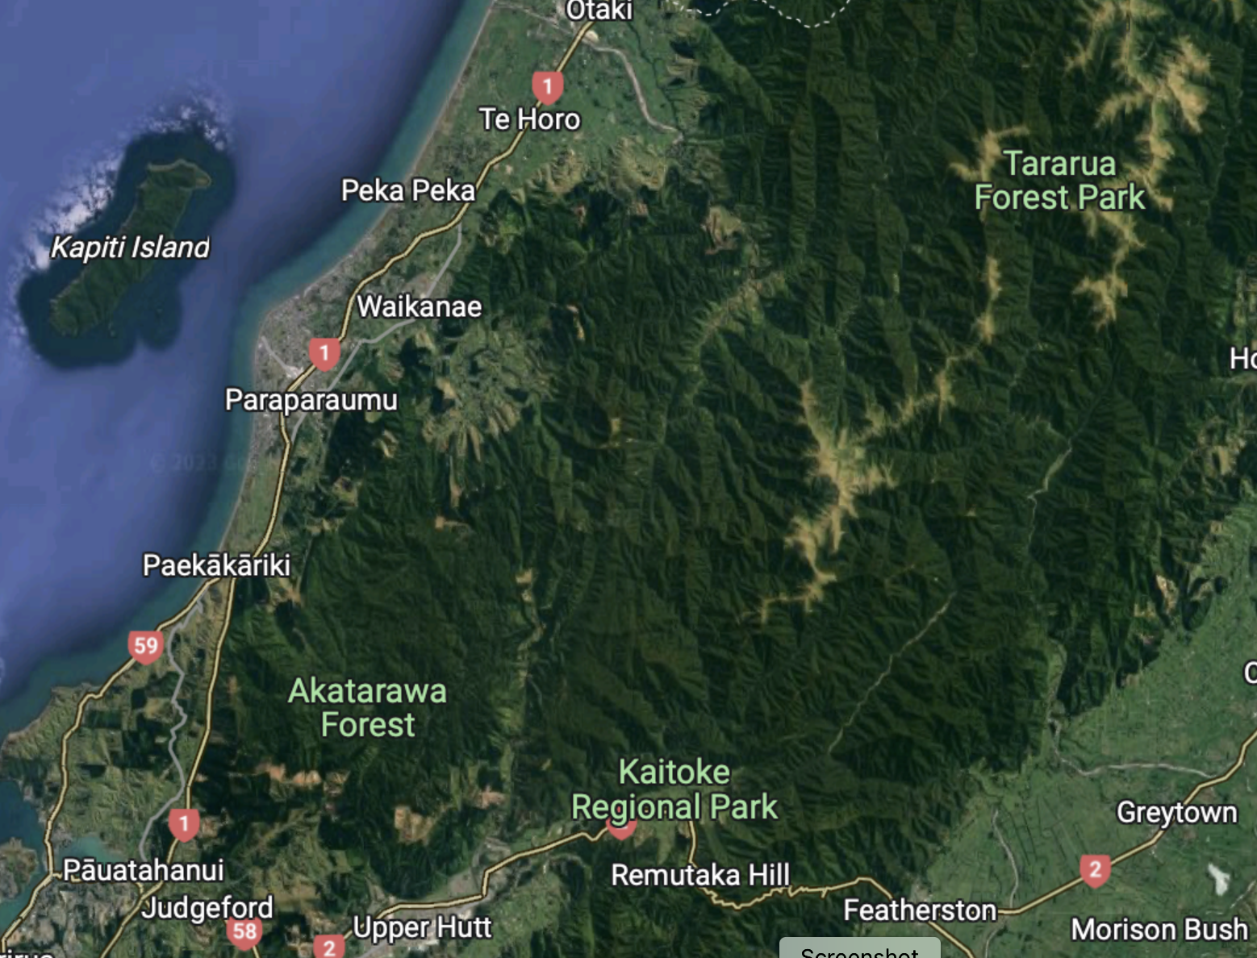
The Akatarawa Valley Community
Residents’s submission
Patricia Laing and Karen Wallace Co-Agents
Notes:
Patricia
we are the 2 coordinators of a 73 group of residents - the group jointly wrote our submission to this PC - is not the work of one person that was then copied and submitted 73 times.
We are a community of neighbours who regularly work together on topical issues. This submission is a good illustration of the way our community comes together to work.

Slide 2
We are surrounded by GWRC who are our neighbours. Our only other neighbour is the Tararua Forest Park which is owned by DOC.
Notes:
Patricia
Our Community is different to other rural areas, the geography of our Valley along with the only neighbour being Forestry - mostly owned by GWRC and a small part DOC.

Slide 3
Good neighbours contribute to a positive and supportive environment
Good neighbours are:
Respectful: Of boundaries, privacy, and personal space.
Helpful: They are willing to lend a hand when needed, whether it’s helping with yard work, pet-sitting, or sharing tools.
Trustworthy: They can be relied upon to respect confidentiality and keep an eye on each other’s homes when someone is away.
Considerate: They are mindful of noise levels and are aware of how their actions affect others.
Communicative: Open and constructive communication helps to resolve misunderstandings and build stronger relationships.
Involved: They participate in community activities or local events, helping to build a stronger neighbourhood.
Supportive: A good neighbour shows empathy and support during difficult times, offering emotional or practical assistance.
Responsible: They maintain their property which contributes to the overall appearance and safety of the neighbourhood.
Understanding: That everyone has different lifestyles and preferences and if conflicts arise are willing to work through them with patience.
Notes:
Patricia
Google search - what does it mean to be a good neighbour.

Slide 4
The Akatarawa residents’ good neighbourly behaviour includes
developing and maintaining activities that allow for food security
harvesting and planting indigenous and exotic species for food, bee forage, medicinal uses and heating purposes
harvesting firewood for heating and cooking
clearing, trimming and maintaining vegetation within 30m of buildings and associated infrastructure to manage wildfire risk, building health, health of solar arrays and collection of water in tanks
clearing and maintaining of tracks, roads, access ways and firebreaks
clearing and maintaining of the banks of watercourses to prevent erosion, sediment runoff and flooding
maintaining gardens associated with buildings and related infrastructure
building and maintaining outbuildings
conducting pest and weed control activities
“rough grazing” of stock such as sheep, cattle, goats, pigs, and horses on existing fenced areas
building and maintaining fencing
Notes:
Patricia
(Notice of Decision for Resource Consent Application for Earthworks and Vegetation Clearance at Upper Akatarawa Valley Properties, RM Ref: 2310003, 10 March 2023, refers).

Slide 5
Good communication and consultation
Thinking holistically from our perspective
Good neighbours communicate respectfully and openly to build strong relationships and resolve issues with patience and understanding
GWRC policy for consultation
- Provide anyone who will or may be affected by, or have an interest in, the decision or matter with reasonable access to relevant information, in a manner and format appropriate to their needs and preferences
- Encourage anyone who will or may be affected by, or have an interest in, the decision or matter to present their views to the Council
PC1 has a poor foundation - engagement with the affected community relied on the Whaitua process and targeted engagement, neither of which happened with our community
42A - More consultation and engagement could have been valuable but this Submission process is an opportunity for all parties to share views and seek changes
We beg to differ
Notes:
Karen
We think about communication and consultation from the perspective of being good neighbours- communicate respectfully and openly
GWRC has principles of consultation which have good neighbourly features - affected people have reasonable access to information and acknowledgement of their preferences.
This hasn’t been our experience.
In hearing stream 1 your advisors 42A report noted the consultation has its foundation in the Whaitua process and targeted engagement. .
Neither of these engaged with our community.
The Hearing stream 1 sec 42A report said more consultation and engagement could have been valuable but this formal submission process is an opportunity to share views and seek changes. We beg to differ . The Plan Change process is long complex and legalistic. Our submission provided a detailed perspective on our experience with this process
We began with this 4 weeks out from xmas producing a group written submission having tried to get to grips with a 350 page plan change(hold up document) with no summary- unlike other councils (hold up Waikato version). This councils one came after we requested it – 15 pages and 9 days before submissions were due (hold it up).
Since then we have spent countless hours monitoring the process, responding to emails when required and reviewing documents
We asked for Plain Language per the plain language legislation and this was ignored by your Sec 42A report
This process is intimidating for most members of our community. It is not our day job, You are asking a lot of our community.
The process has been going for 18 months. The end isn’t even in sight.
P

Slide 6
We don’t feel heard or respected. We ask you to engage with our community
Process is long complex legalistic and the material that we need to understand is technical and voluminous not helped by short timeframes
We request communication in accordance with Plain Language Act 2022 (ignored by Sec 42A report)
Presenting at this hearing isn’t for the fainthearted
This is a poor alternative to community engagement. Four (there were many more) quotes from 42A report (500 pages) illustrate this:
  “some submitters appear to have misunderstood how the rule would operate”
  “there may be some misunderstanding with the rules as written”
  “some submitters appear to have misunderstood the rule”
  “no response as relief wasn’t specified”
Notes:
Karen
We ask you to walk in our shoes.
The Plan Change process is long complex and legalistic. Our submission provided a detailed perspective on our experience with this process .
We began with this 4 weeks out from Xmas producing a group written submission having tried to get to grips with a 350 page plan change (hold up document) with no summary - unlike other councils (hold up Waikato version). This Council’s one came after we requested it – 15 pages and 9 days before submissions were due (hold it up).
Since then we have spent countless hours monitoring the process, responding to emails when required and reviewing documents.
We asked for Plain Language per the plain language legislation and this was ignored by your Sec 42A report.
This process is intimidating for most members of our community. It is not our day job, You are asking a lot of our community. Noone else, despite PHD’s, lawyers and tertiary education, wanted to present to you. This is not a good way to engage with our community. We are ready and willing to meet and discuss. This submission process is too blunt an instrument to replace respectful and open community engagement.
The process has been going for 18 months. The end isn’t even in sight. In absence of more engagement and consultation your advisor suggested this process was the alternative.
These quotes indicate the poor quality of engagement with submitters.
Simple example: the splitting of material across 5 streams works for you - for us, you want us to split our community concerns into 5 slices. And we then need to come to present at least 3 times to each of the 3 relevant streams.
We repeat, please engage with our community. It is easy, we have an established network and a community that is interested in sustainable rural lifestyles.

Slide 7
Following our review of 42A Report we recommend that:
the small holder provisions are not reinstated once the risk index tool is developed. We request that you accept the recommendation to remove small holder provisions (4-20 hectares) from PC1. The risks of nitrate losses and contamination are low and without information to the contrary the compliance requirements are overly onerous.
the implementation of proposed controls and requirements for our community including those blocks over 20 hectares be paused until there is evidence of a problem. The proposed FEP comes at a cost ($3-4k to $10k) with the “benefits difficult to quantify” (42A report)
the designation of property management plans set out in the gazette NPS-IB namely QEII, Conservation and other approved property management plans be accepted. We saw no response to our request to exclude land registered in the Emission trading scheme, QE 2 Trust or Conservation property.
Notes:
Karen

Slide 8
Following our review of 42A Report we also recommend that:
funding be allocated for testing the water quality of the Akatarawa River at a minimum of three stations. Currently there is no testing within the flow of Akatarawa River. If run off affects the water quality then it is the responsibility of GWRC because GWRC own significant pieces of land adjacent to the River.
the terminology referring to “unplanned greenfield areas” in the Akatarawa Valley be changed because it is misleading. (We note that this will be covered in Hearing stream 4)
Notes:
Patricia
In absence of GWRC water testing our community is considering doing our own testing. We would like you to fund this.
Describing area of Akatarawa valley as “unplanned green fields” grossly misrepresents our area - it is to be covered in hearing stream 4 and we won’t attend (side bar illustrates again the process is onerous as we needed to attend 3 hearing streams to cover all our issues. Whilst we are reminding you of it today we don’t have the benefit of the 42A report.

Slide 9
Pest control
We request clarification about the impact of pests on the Akatarawa Valley Community’s ability to improve the quality of our ecosystem, manage stock levels, and the water quality of the Akatarawa River. Even though we have been informed that pest control has been identified as outside the scope of Plan Change One clarification is required. Pests have been identified as the main reason for our lack of success in improving the quality of our ecosystem, for the effects of overstocking, and potentially the water quality of the Akatarawa River.
We request that the GWRC engage with the Akatarawa Valley Community to agree pest levels and a process for maintaining them. We know pests cannot be eliminated but we want evidence of GWRC making a concerted effort to cull pests so they don’t exceed agreed levels.
Notes:
Patricia
Our community continues to be plagued with deer, pigs, hares, rabbits, rats, possums, stoats, feral sheep, feral cows, and goats - the majority originated from GWRC land. We pay for the damage they cause to our land. We are a good neighbour and assist with 1080 drops. The main stumbling block to indigenous biodiversity on our land is these pests eating the bush understory.
Pig Story

Slide 10
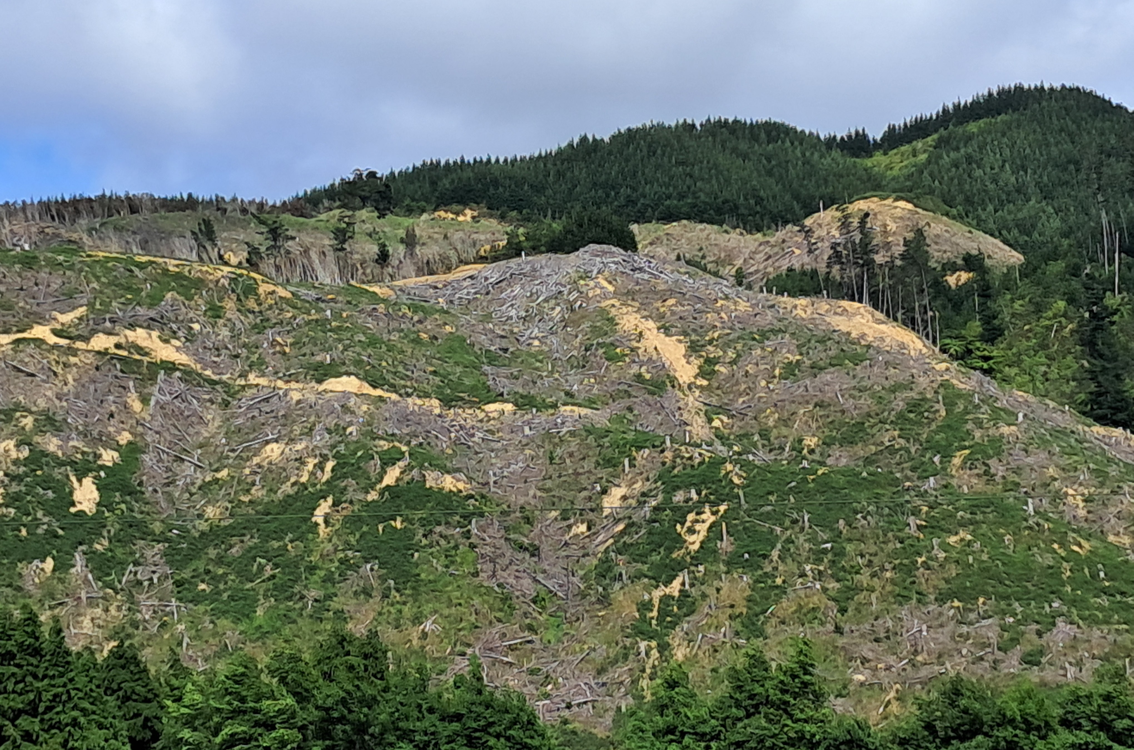
We request that GWRC model best practice when managing its land.
Notes:
Patricia
This is a small portion of GWRC land adjacent to a resident’s land where the recent felling has left trees and related slash to slide down the hill and eventually pollute the river.
We ask the GWRC manage its land in the same way we are being asked to.

Slide 11
Conclusion
The Akatarawa Valley Community as a good neighbour recommends that GWRC:
present any future information in a way that is easy to understand and make the process less burdensome.
gather evidence to support targeted and tailored strategies for specific ecologies.
consider the costs and impacts of the PC provisions on rural lifestylers.
acknowledge that our land, and our ability to manage it, is impacted by how well, or not, the surrounding GWRC land is managed.
engage with your connected, active and interested neighbour.
Notes:
Patricia

